Slide 1
Salon management System
Subtitle: Staff management module.
Presented by: MUYOMBYA ALLAN Number: 2025/BCS/132/PS University: Mbarara University of Science and Technology (MUST) Department: Computer Science

Slide 2
Application Domain & Business Case
Domain: The Professional Beauty Salon.
The Problem: Traditional paper-based systems lead to scheduling conflicts, inaccurate commission tracking, and a lack of performance data.
The Solution: A centralized relational database that tracks the full lifecycle of salon staff.
Why it Matters: To improve operational efficiency and ensure data-driven decision-making for salon owners.

Slide 3
System Requirements & User Groups
Key Requirements:
Personnel and Role management.
Conflict-free shift scheduling.
Skill certification tracking.
Daily attendance and leave management.
User Groups:
Administrator/Owner: Payroll and performance oversight.
Receptionist: Real-time scheduling and customer-to-stylist matching.
Stylists/Staff: Viewing work rosters and tracking earnings.

Slide 4
Analysis of Benefits & Costs
Intangible Benefits
Analysis of Benefits & Costs
80% reduction in manual payroll processing time.
Elimination of financial overpayments due to human error.
Increased staff accountability and transparency.
Professionalized business image.
Costs
Low overhead due to open-source software (XAMPP/MySQL).
Minimal training and maintenance costs.

Slide 5
Logical Design
Roles: Salary and commission definitions.
Staff: Core personnel data.
Shifts: Master time blocks.
Staff_Schedules: The daily work roster.
Skills: Service capabilities directory.
Staff_Skills: Certification bridge table (Many-to-Many).
Attendance: Daily clock-in/out performance logs.
Leave_Requests: Absence management.

Slide 6
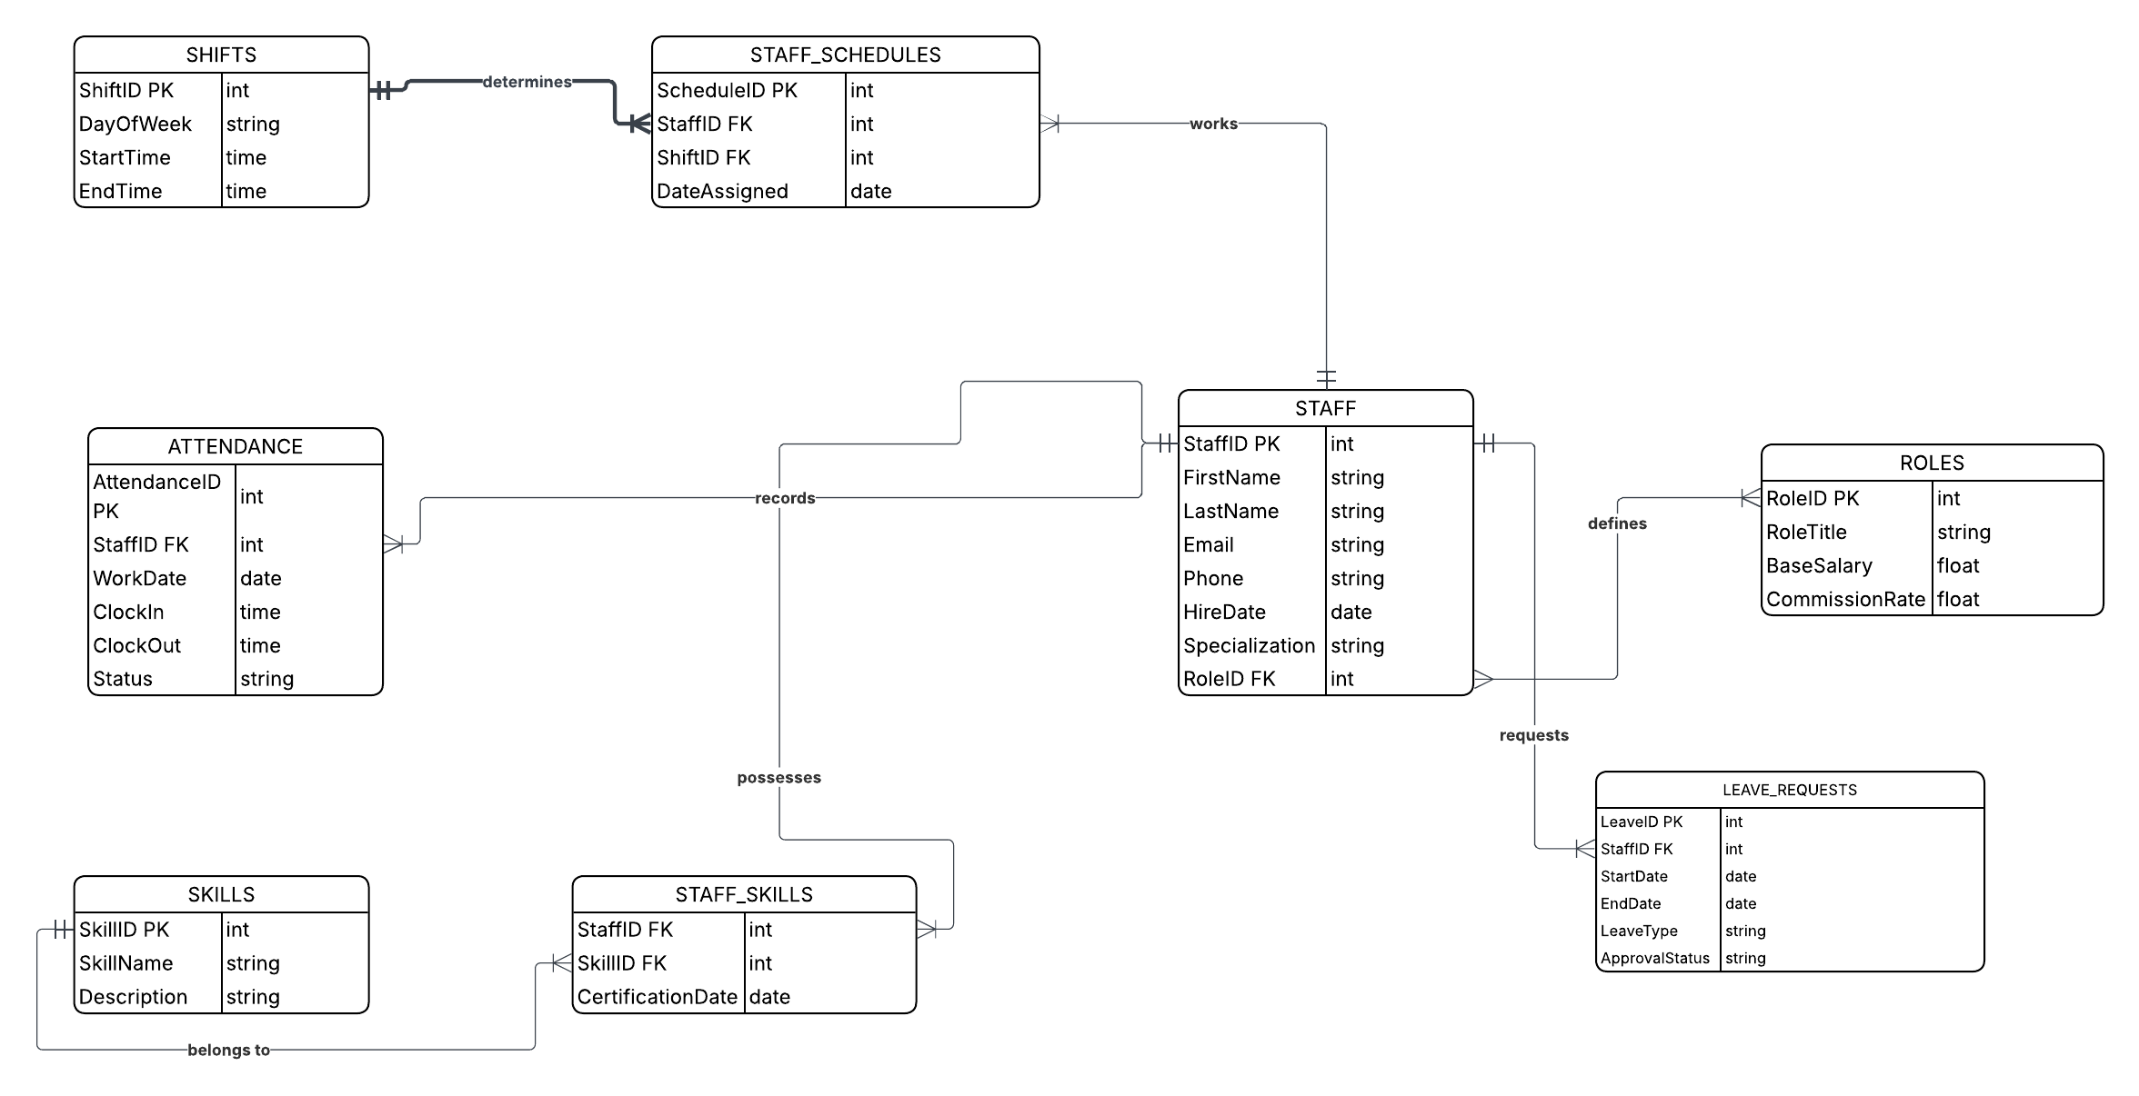
Entity Relationship Diagram (ERD)

Slide 7
Entity Relationship Diagram (ERD) cont’d
Total Entities: 8 Relational Tables.
Database Normalization: Designed in 3rd Normal Form (3NF) to prevent data redundancy.
Notation Style: Standard Crow’s Foot Notation used for visual clarity.

Slide 8
Entity Relationship Diagram (ERD) cont’d
Referential Integrity: Enforced via Mandatory Multiplicities.
Core Hub: The STAFF table acts as the central link for all tables (Scheduling, Skills, and Performance).

Slide 9
Key Relationship & Business Logic
Scheduling Logic: A Many-to-Many relationship between STAFF and SHIFTS is resolved via the STAFF_SCHEDULES bridge table.
Competency Matrix: STAFF_SKILLS allows the salon to track multiple certifications for a single stylist.
Performance Monitoring: One-to-Many relationships link STAFF to ATTENDANCE for daily punctuality tracking.
HR Management: LEAVE_REQUESTS table ensures conflict-free absence management.
Financial Standardization: ROLES table ensures fixed salary and commission rates across all employee tiers.

Slide 10
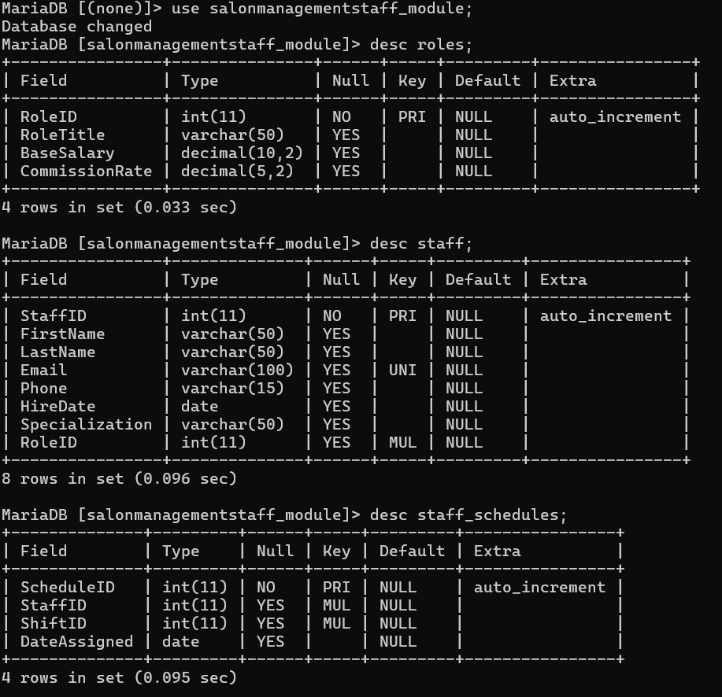
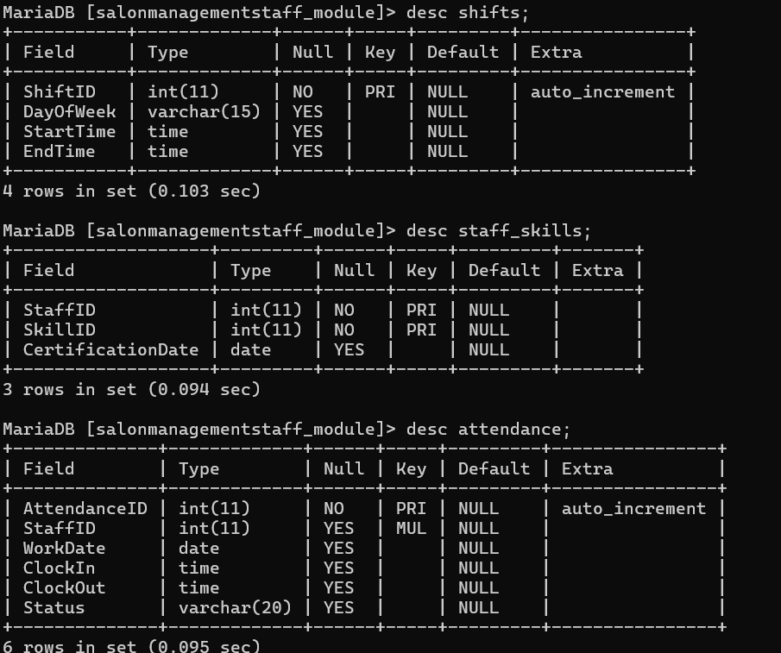
Implementation (XAMPP & MySQL) Shell

Slide 11
Implementation cont’d
Physical Schema Realization: Direct transformation of the 8-table logical ERD into mysql.
Metadata Definition: use of data types (INT, VARCHAR, DECIMAL, TIME, DATE) to optimize storage and data accuracy.
Relational Integrity: Use of Primary Keys (PRI) for unique indexing and Foreign Keys (MUL) for mandatory cross-table linkages.
Integrity Constraints: Use of UNIQUE indexing on email fields and NOT NULL requirements to ensure data completeness and prevent redundancy.

Slide 12
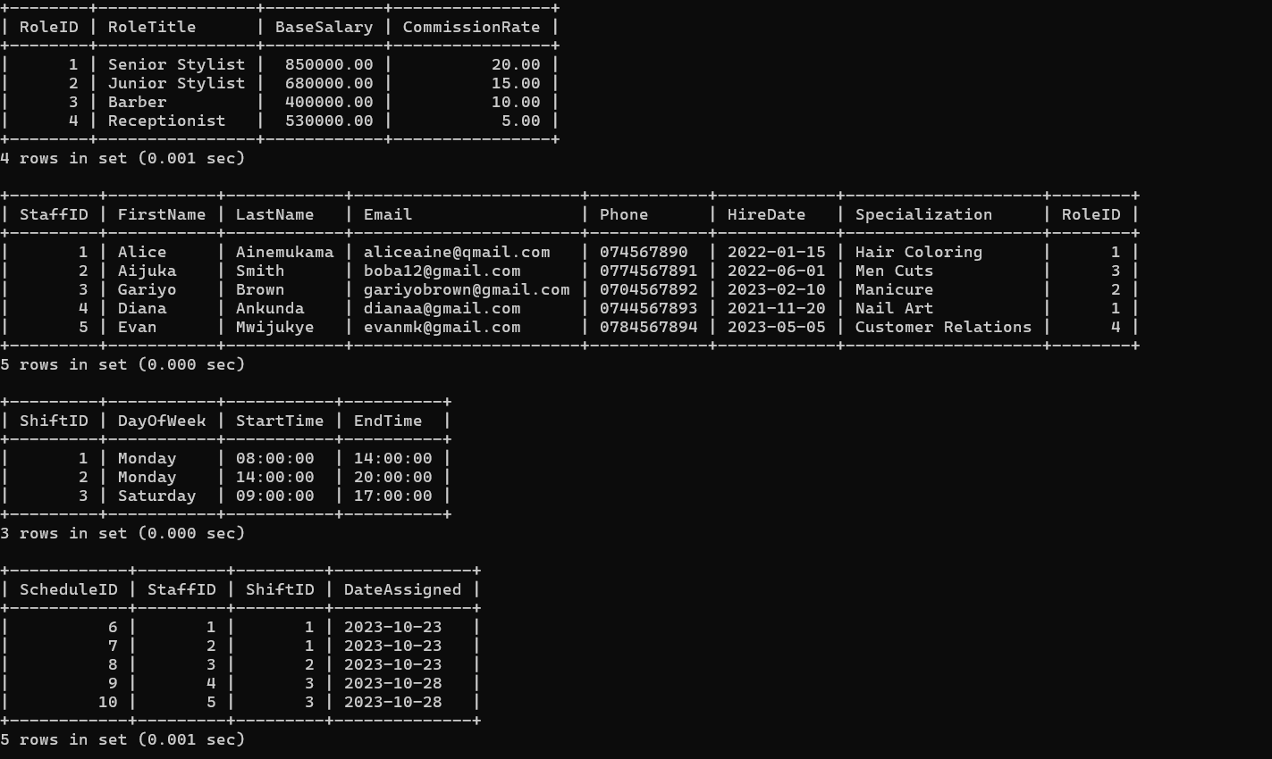
Data Tables

Slide 13
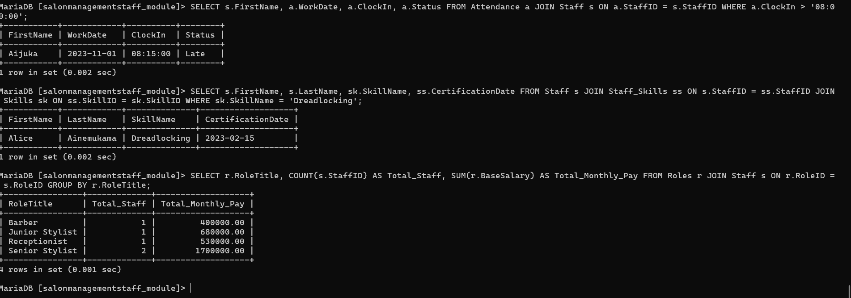
System Queries & Business Intelligence

Slide 14
Technical Highlights of the Queries
Query 1:Using relational JOINs between Attendance and Staff to monitor punctuality of late coming.
Query 2: Utilizing a 3-Table JOIN (Staff, Staff_Skills, Skills) to resolve many-to-many relationships for specialized service booking ie Dreadlocking skill.
Query 3: Implementing GROUP BY and aggregate functions to generate real-time payroll forecasts.

Slide 15
Comparable System Analysis & Limitations
Benchmarking: I have studied real-world systems like Fresha and Squire.
Key Learning: Learned the importance of Competency-Based Scheduling like linking specific skills to staff profiles to avoid booking errors.
System Limitations:
Currently lacks automatic PAYE (Tax) and NSSF calculations.
No integrated Mobile Money API for automated salary disbursement.
Leave approvals are still a manual administrative task within the database.
Future Scope: Implementation of a "Point of Sale" (POS) module to link staff performance directly to sales revenue.

Slide 16
Conclusion & Bibliography
Key References:
Elmasri & Navathe (2017): Fundamentals of Database Systems.
Coronel & Morris (2018): Database Design & Management.
MySQL 8.0 Official Manual: Oracle Documentation.

Slide 17
Conclusion & Bibliography
Benchmarking Sources: Fresha and Squire Salon Platforms.
Final Conclusion: The system successfully achieves 3rd Normal Form (3NF) to provide an efficient, scalable solution for Salon Staff Management.
Project Repository: [https://github.com/allanmuyombyabcs132/DATABASE-STAFF-MANAGEMENT.git]
YouTube video link [https://youtu.be/nUxmvzjtOw0?si=CmQoMmASApAKe_VC]

Slide 18
Thank you!!!!!!

